Slide 1
Spatial Archive
Thomas Klein, Rohan Chandrasekar, Mya Chappell

Slide 2
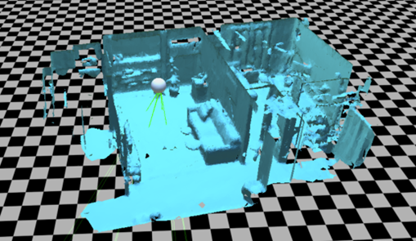
Objective: Store and Visualize Spatial Mapping Data
Benefits:
Monitoring for construction sites
Used by other devices (e.g. robots, drones, etc.)

Slide 3
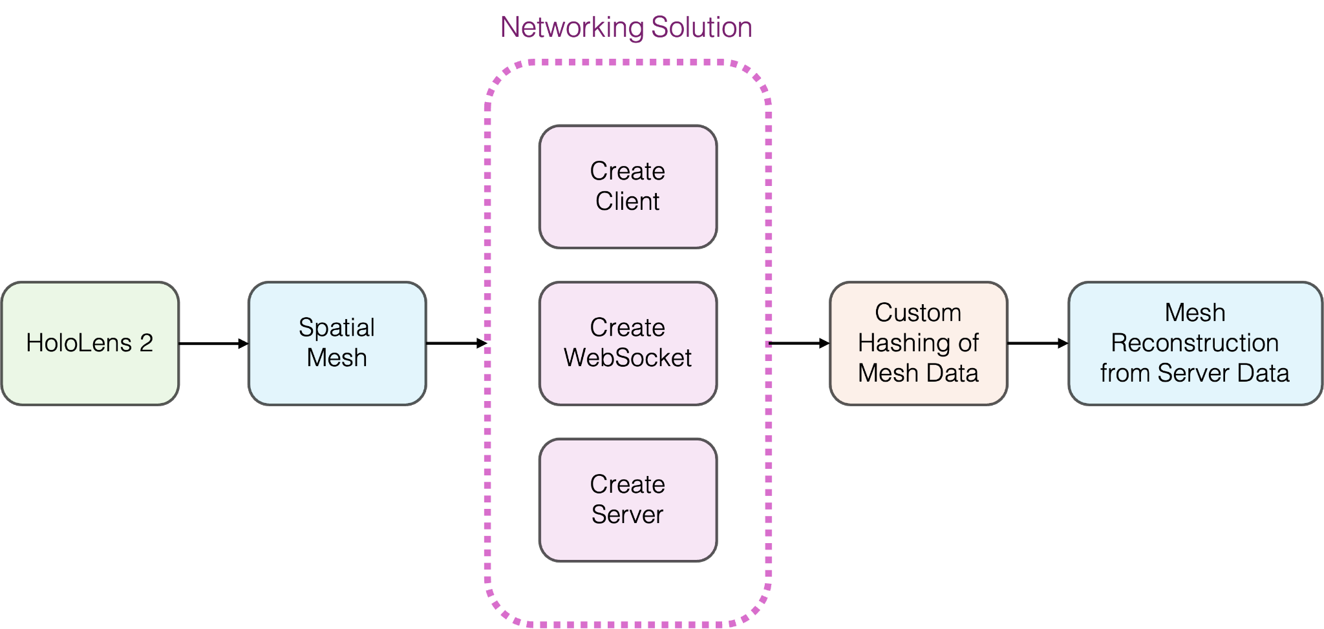
Scope of the Project

Slide 4
Reach Goals
Potential reach goals if we have time could be:
Mesh Comparison
Mesh Segmentation
Mesh Classification

